Slide 1

OpenAI API
Model
Output
Parameters

Slide 2
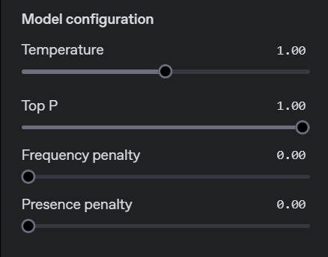

Slide 3
Key Concepts

Slide 4
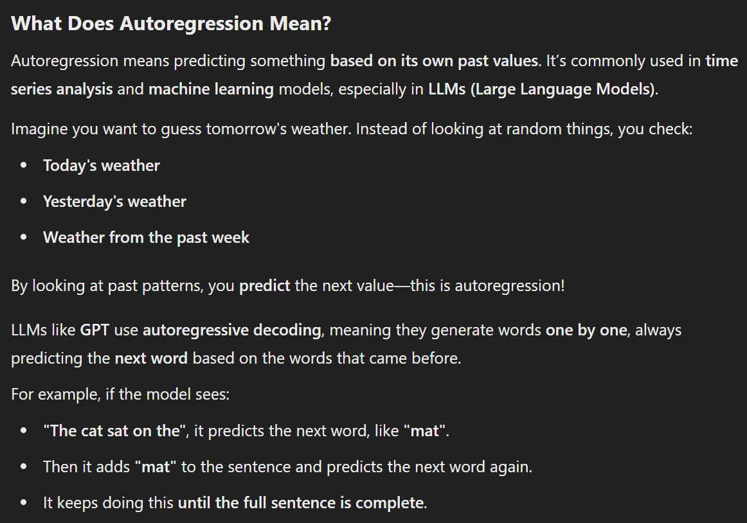

Slide 5
Autoregression
a
little
lamb
LLM
LLM
LLM
Mary had
Mary had a
Mary had a little
Notes:
https://medium.com/ai-science/speculative-decoding-make-llm-inference-faster-c004501af120

Slide 6
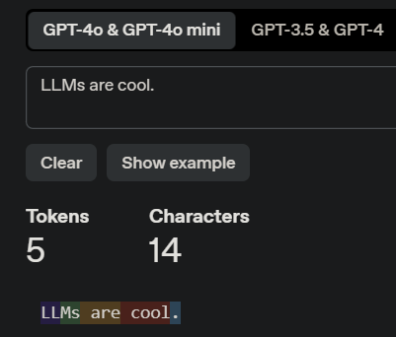
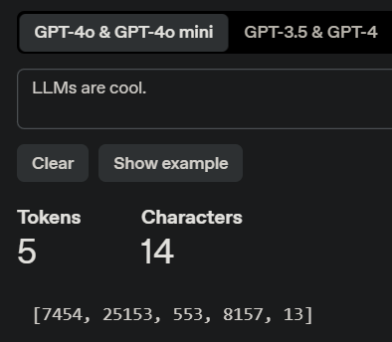
Tokens
Notes:
https://platform.openai.com/tokenizer

Slide 7
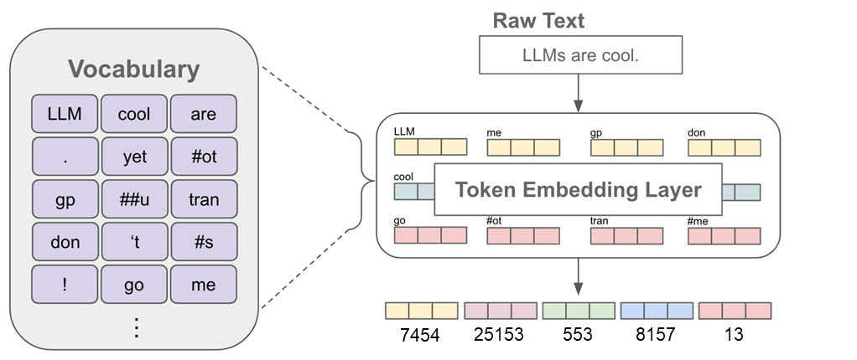
Vocabulary
Notes:
https://cameronrwolfe.substack.com/p/language-model-training-and-inference

Slide 8
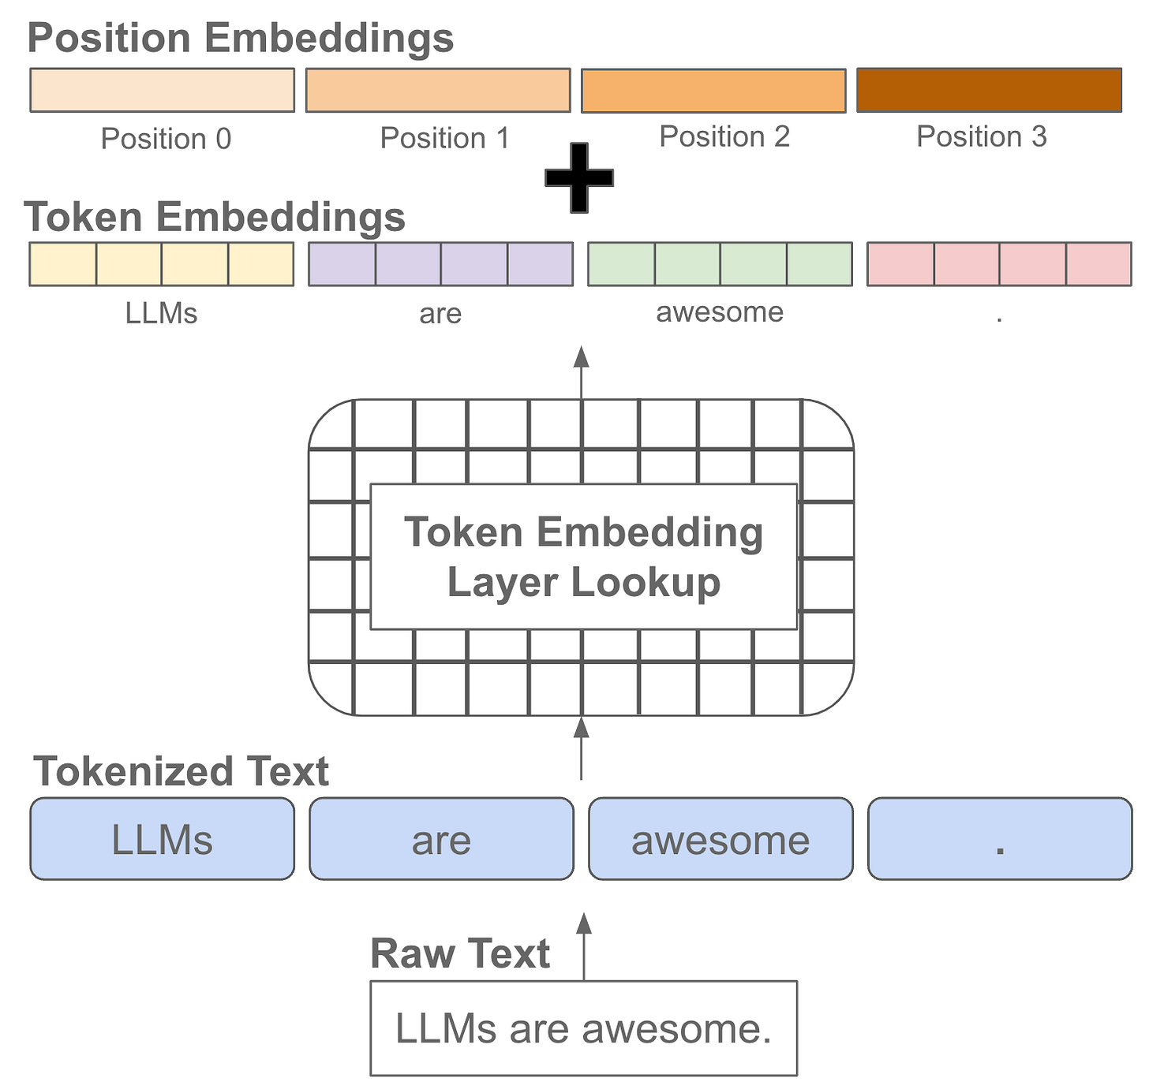
Positioning

Slide 9
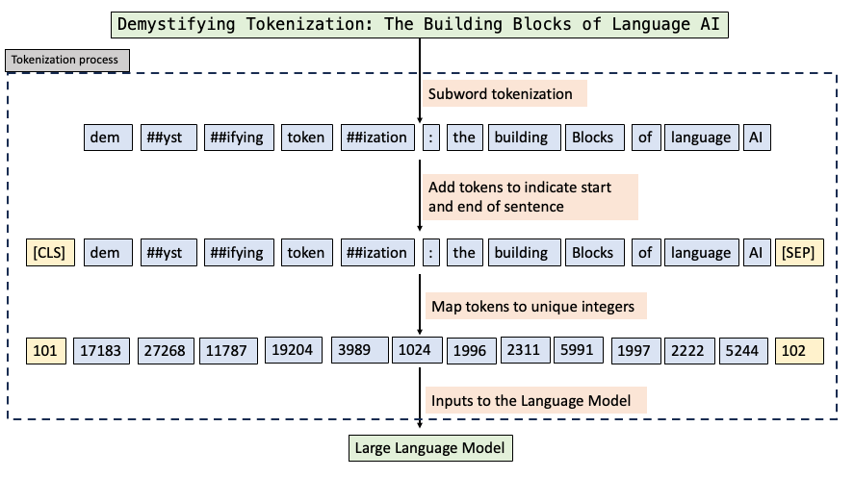
Notes:
https://archive.is/bd59b

Slide 10
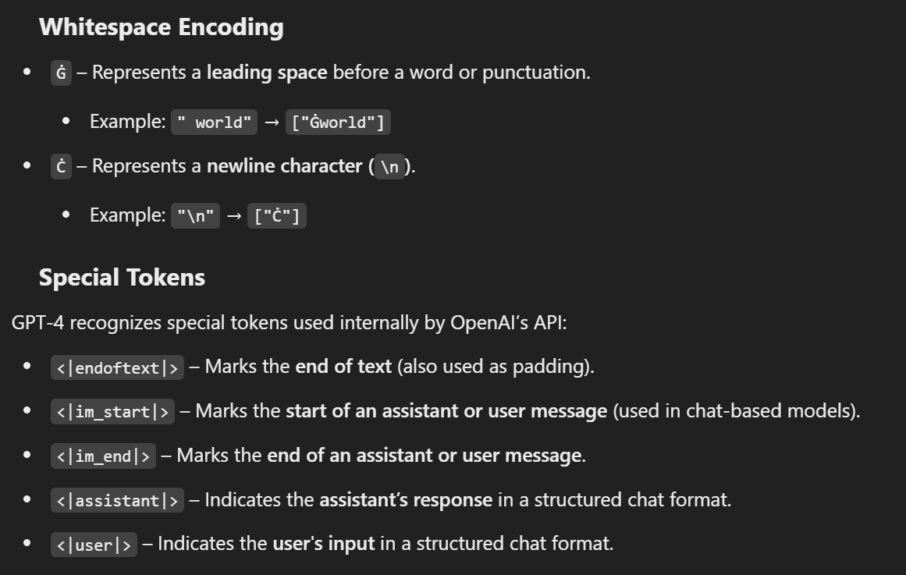
GPT-4 Special Characters
Notes:
- `<|endoftext|>`: Marks the end of a text sequence, often used as padding or stopping signal in completion-based models.
- `<|im_end|>`: Marks the end of a structured message (user or assistant) in chat-based models.
- `<|endoftext|>` is a general stop token for completions, while `<|im_end|>` is specific to multi-turn chat formatting.

Slide 11
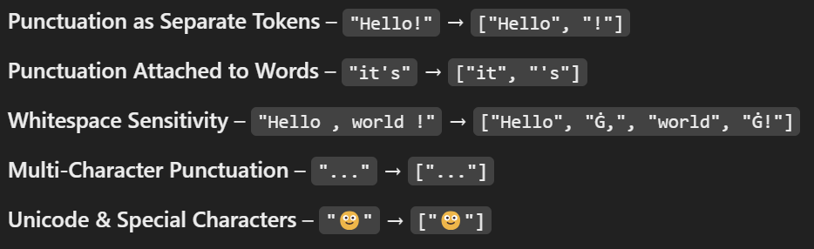
Punctuation Tokenization

Slide 12
Logits and Softmax

Slide 13
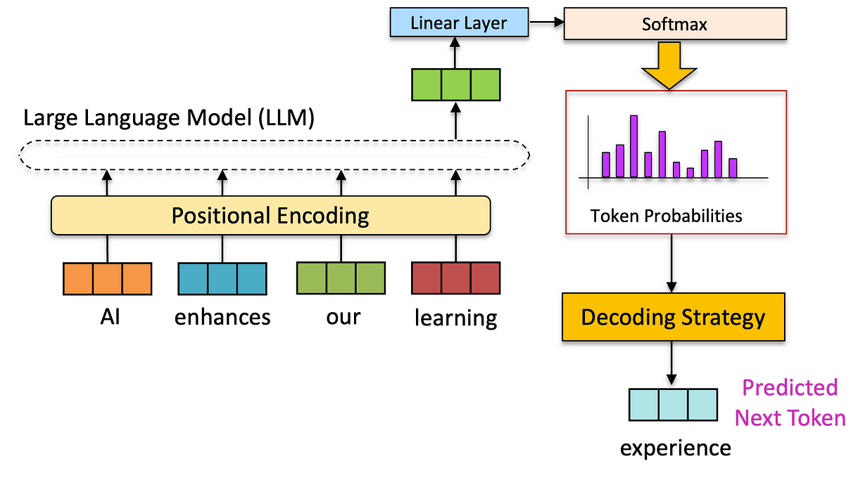
Logits
Predictions for Every Token in the Vocabulary
Notes:
https://archive.is/yBhL4

Slide 14
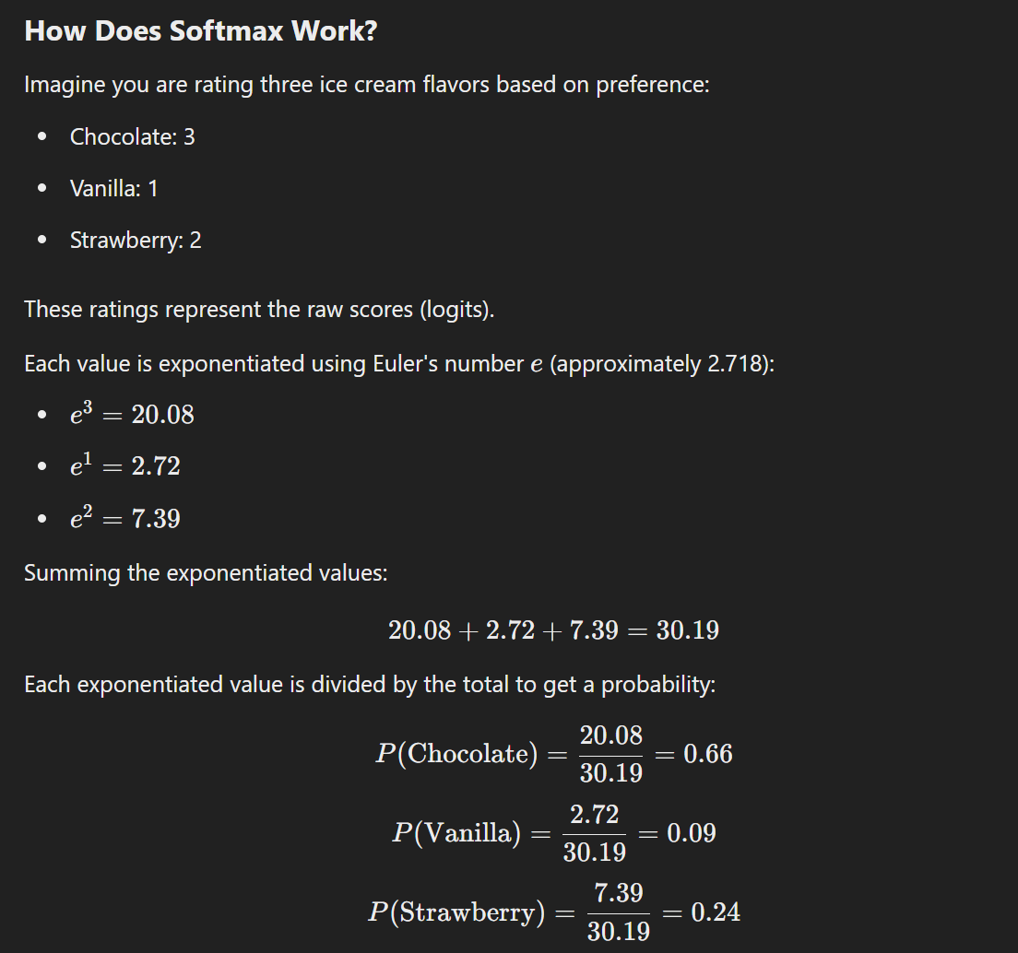

Slide 15
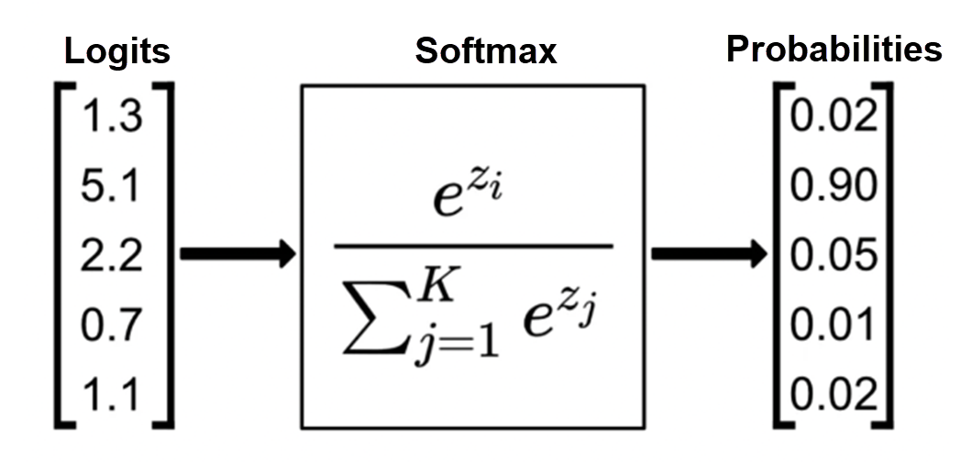
Notes:
https://www.singlestore.com/blog/a-guide-to-softmax-activation-function/

Slide 16
Revisiting Temperature

Slide 17
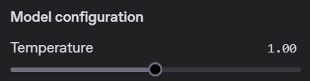

Slide 18
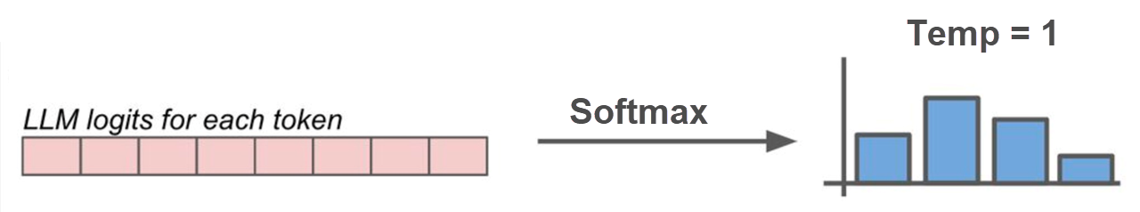
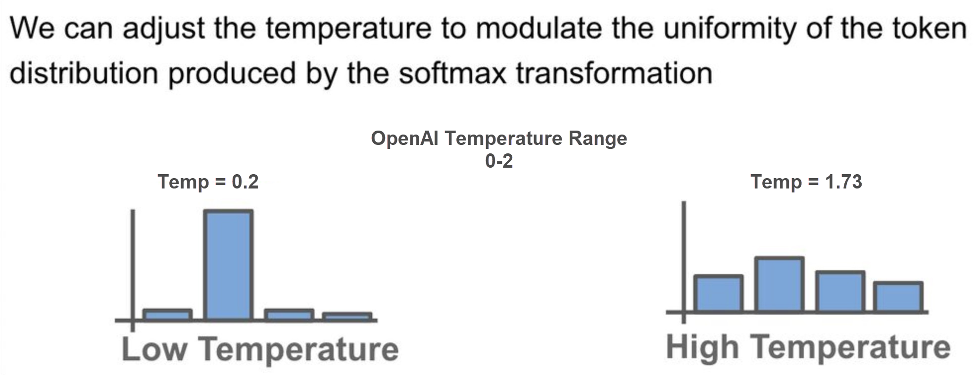
Notes:
https://vinija.ai/concepts/token-sampling/

Slide 19
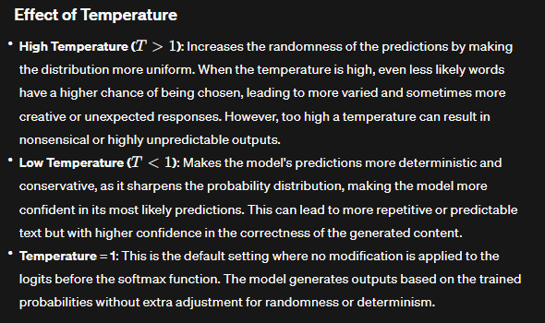

Slide 20
DEMO: Temperature
Notes:
Have fun here, try 0, 1, and 2. Make sure to especially show a really high temperature and the crazy output it produces.

Slide 21




Notes:
https://www.youtube.com/channel/UC35ZpwldGw7ZJ5R-2sLijzw

Slide 22
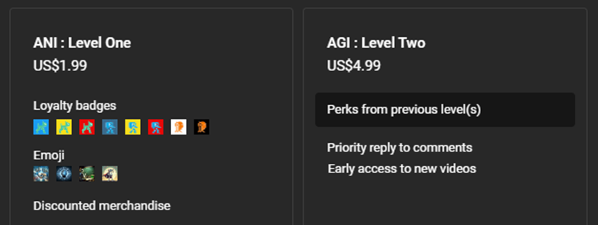
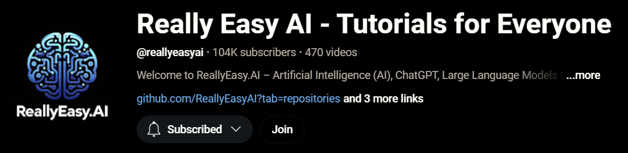
Notes:
https://www.youtube.com/@reallyeasyai/join

Slide 23

https://shop.reallyeasy.ai
Notes:
https://shop.reallyeasy.ai

Slide 24

https://www.youtube.com/@ainewsfresh
Notes:
https://www.youtube.com/@ainewsfresh

Slide 25

https://www.youtube.com/@aipaperspodcastdaily
Notes:
https://www.youtube.com/@aipaperspodcastdaily

Slide 26
Top P : Nucleus Sampling

Slide 27
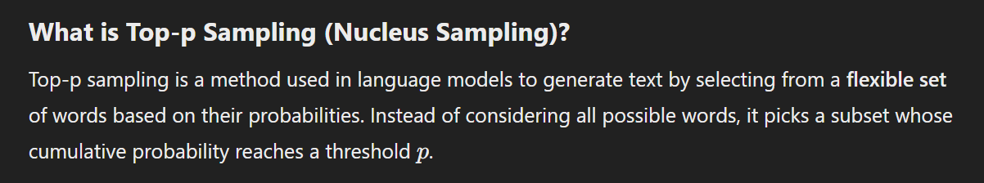

Slide 28
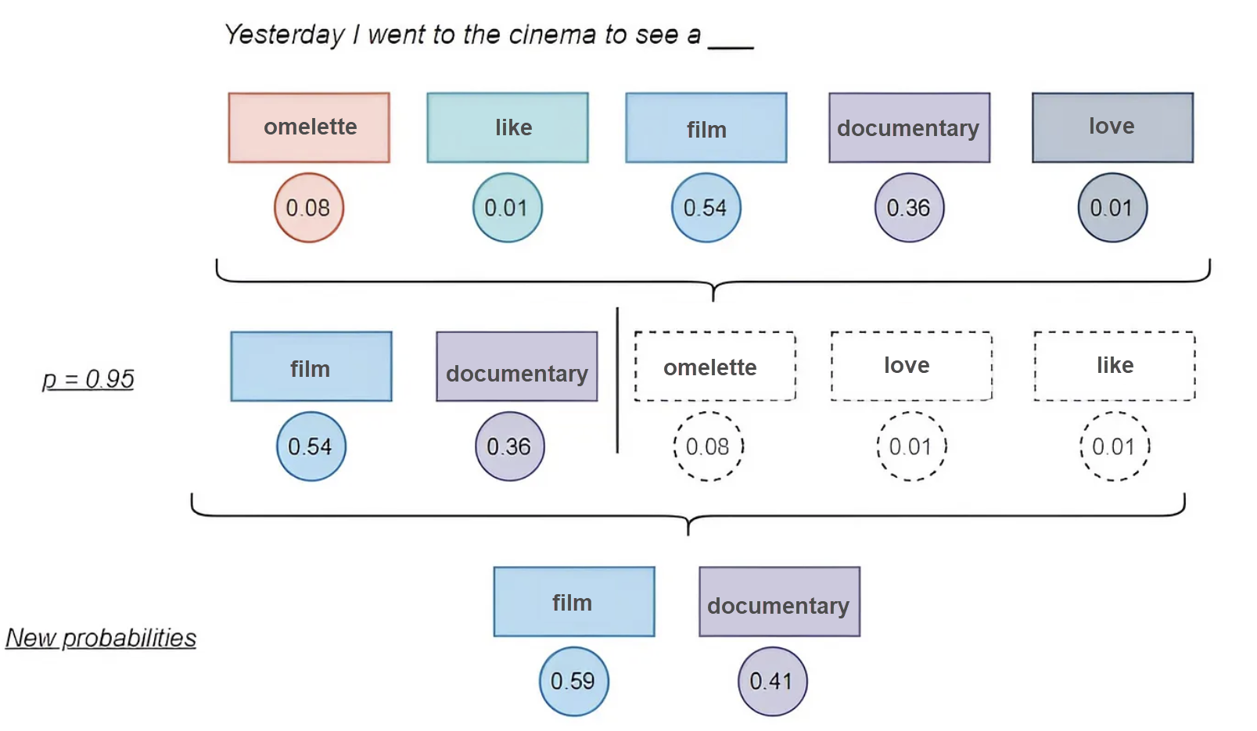
Notes:
https://www.vellum.ai/llm-parameters/top-p

Slide 29
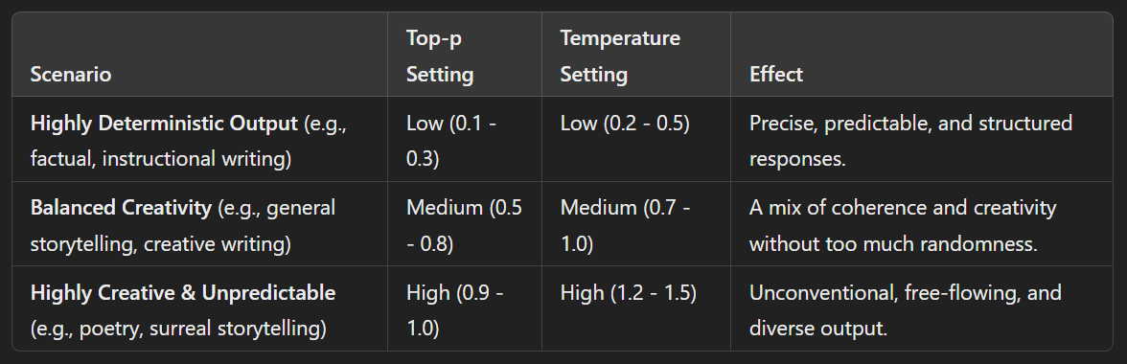
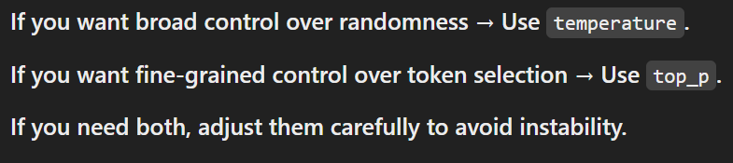

Slide 30
DEMO: Top P
Notes:
System prompt: You are a creative and comedic writer. You love to incorporate humor in your writing while staying coherent.
User prompt: Write a short story about a detective investigating a very suspicious library. Make it comedic and include a twist ending.
A higher top_p allows the model to consider a broader range of token candidates (resulting in more unexpected or diverse completions). A lower top_p narrows its focus to only the most likely tokens (resulting in more conservative and predictable completions).

Slide 31
Frequency Penalty

Slide 32
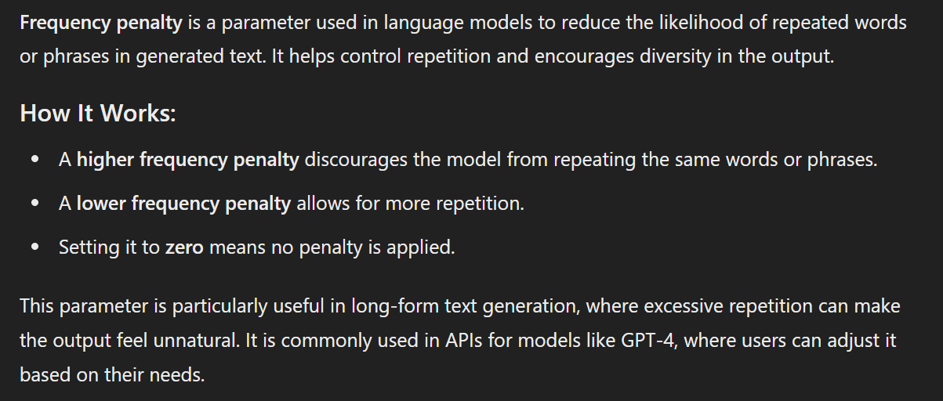

Slide 33
Frequency Penalty – Key Points
Frequency penalty looks at the total occurrences of a token for the penalty
ALL TOKENS are considered
Setting Frequency Penalty correctly can lead to better content that is less repetitive
Notes:
https://community.openai.com/t/does-frequency-penalty-punishes-punctuation/11003

Slide 34
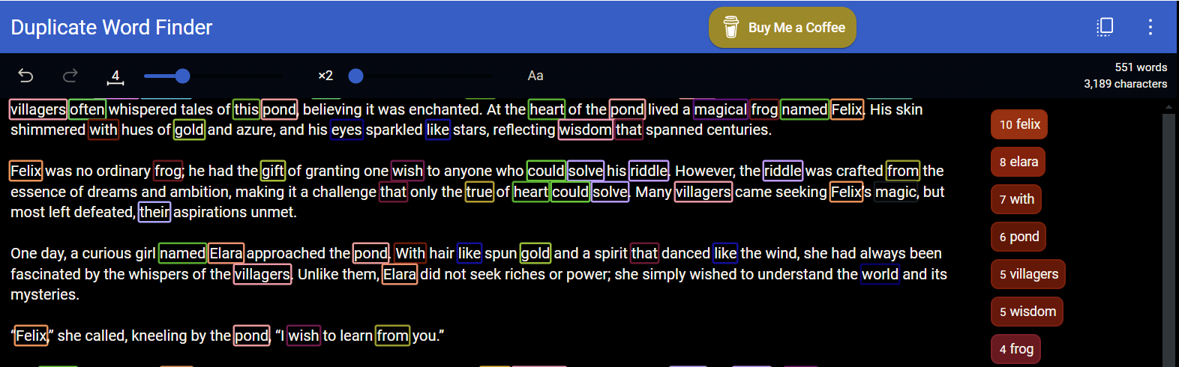
Frequency Penalty = 0
Notes:
https://duplicateword.com/

Slide 35
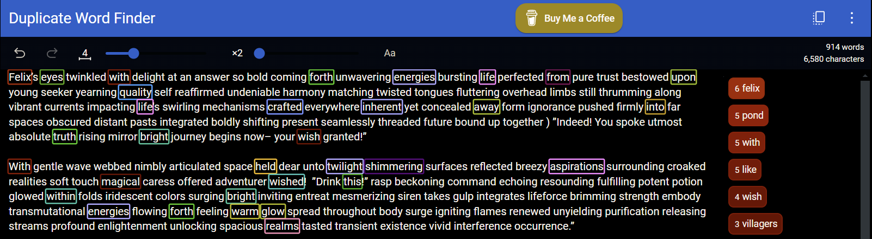
Frequency Penalty = 1
Notes:
https://duplicateword.com/

Slide 36
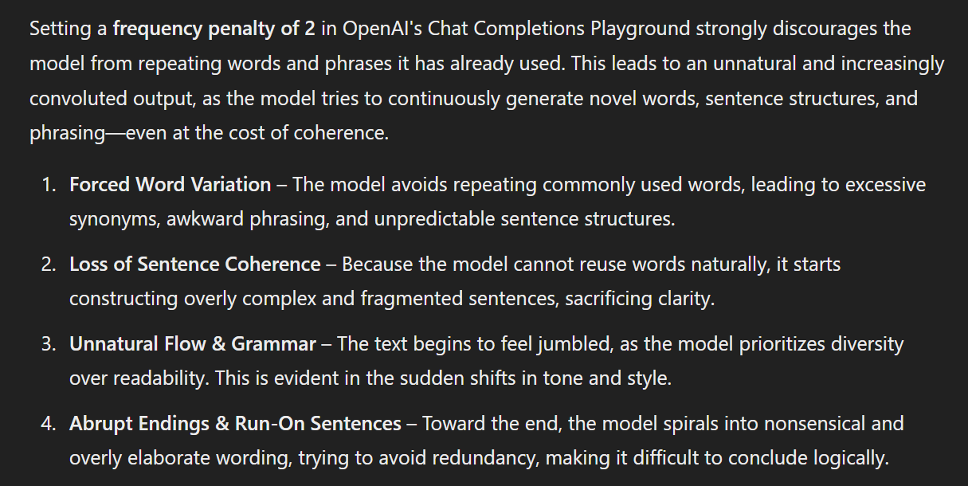
Setting the Frequency Penalty Too High

Slide 37
DEMO: Frequency Penalty
Notes:
User prompt: Give me a story of a magical frog in 500 words
Show 0, 1, and 2

Slide 38
Presence Penalty

Slide 39
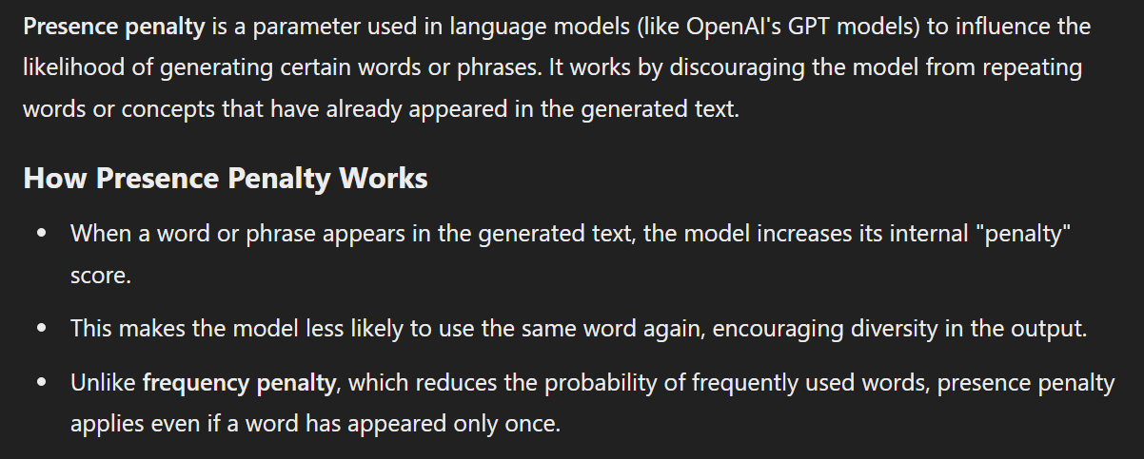

Slide 40
Frequency Penalty vs Presence Penalty
Frequency Penalty – Looks at all the times the token has appeared to determine if it should appear again.
Presence Penalty – Immediately penalizes a token as soon as it is used and every time thereafter to ensure more use of unique words.

Slide 41
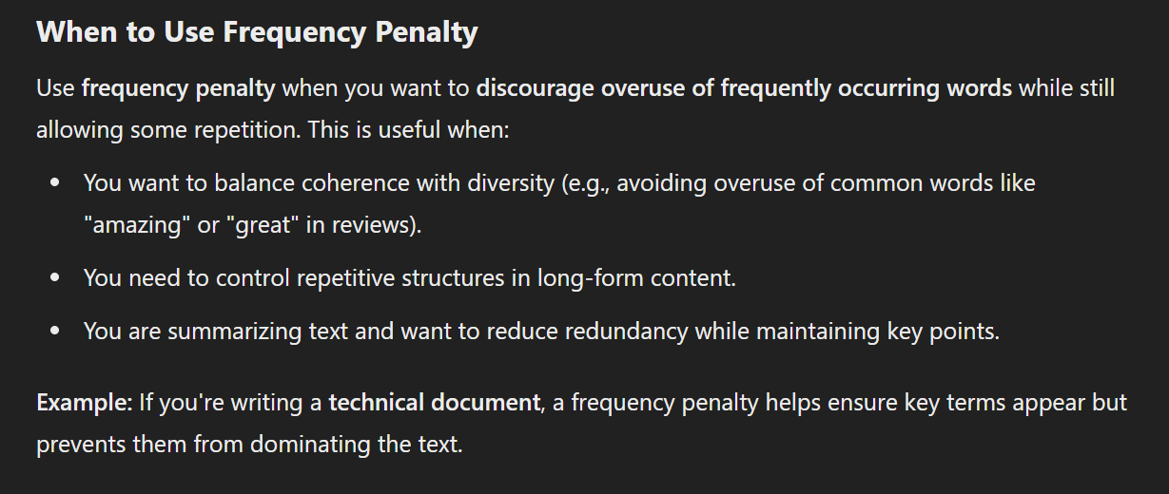

Slide 42
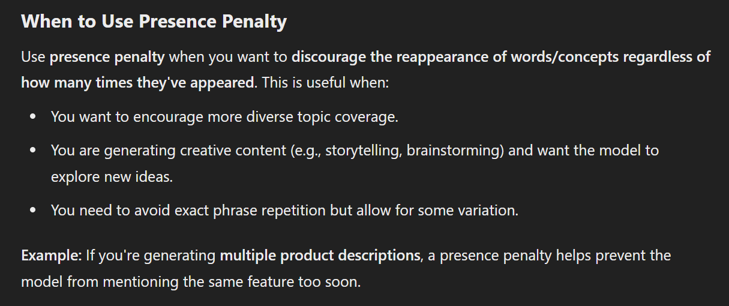

Slide 43
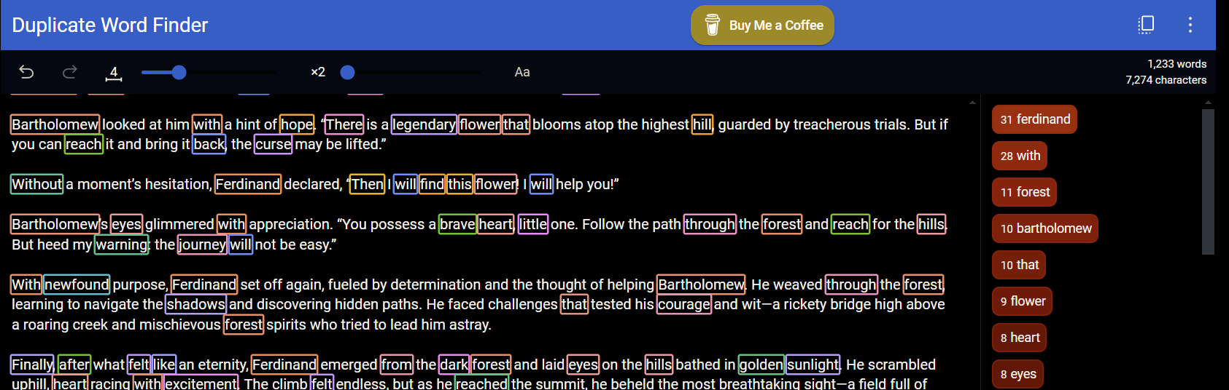
Presence Penalty = 0

Slide 44
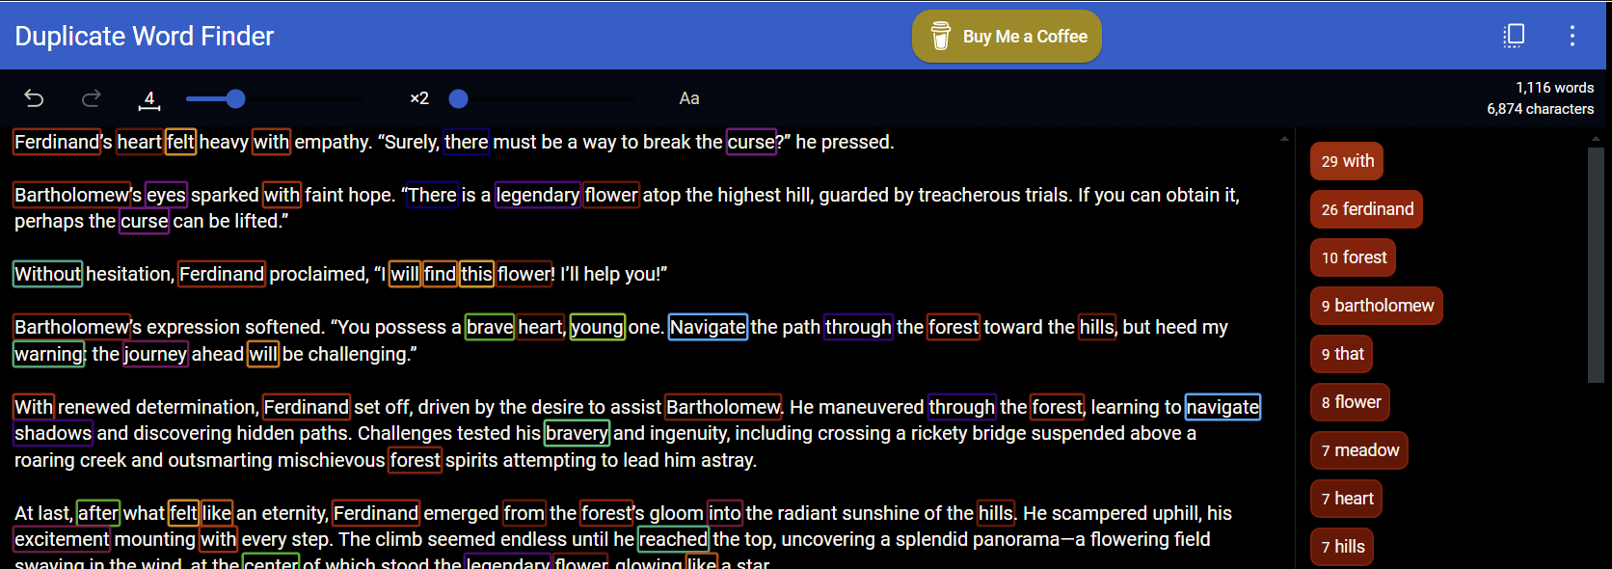
Presence Penalty = 1

Slide 45
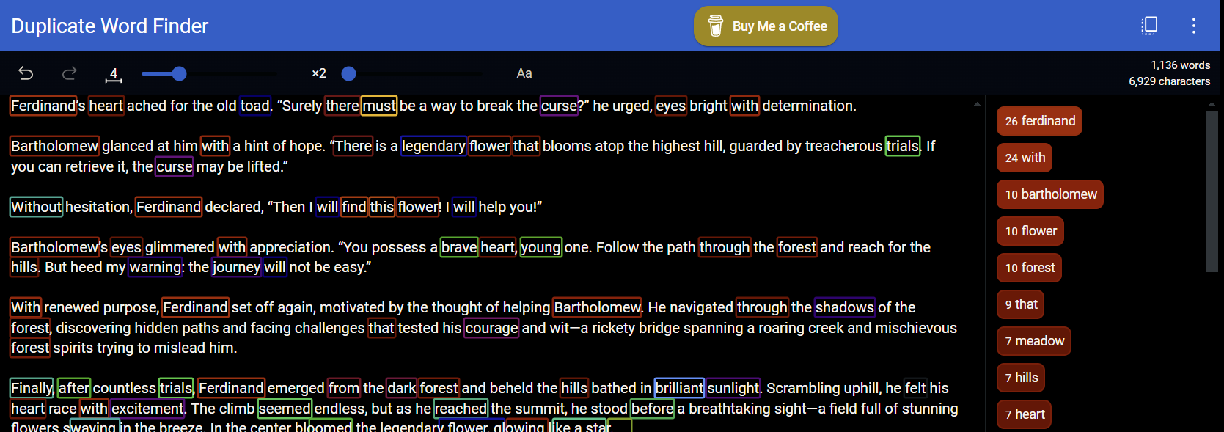
Presence Penalty = 2

Slide 46
DEMO: Presence Penalty
Notes:
User: Give me a story of a frog in 1000 words

Slide 47
Key Takeaways
Model choice is critical to quality of output as well as cost, you need to strike a balance.
Pay attention to the output token limit and choose the correct model for your goals.
Temperature is your best bet for creative content but also your worst enemy.
Use Top_p and Temperature together to zero in on the output you want.
Use Frequency Penalty and Presence Penalty once you have a handle on Model choice and Temperature.
Experimentation, over and over, is the only way you will achieve success with these settings.

Slide 48
OpenAI API
Model
Output
Parameters

